Slide 1

Chapter 1
The Process of Portfolio Management

Slide 2
The Life of every man is a diary in which he means to write one story, and writes another; and his humblest hour is when he compares the volume as it is with what he vowed to make it.
- J.M. Barrie

Slide 3
Outline
Introduction
Part one: Background, Basic Principles, and Investment Policy
Part two: Portfolio construction
Part three: Portfolio management
Part four: Portfolio protection and contemporary issues

Slide 4
Introduction
Investments
Security analysis
Portfolio management
Purpose of portfolio management
Low risk vs. high risk investments
The portfolio manager’s job
The six steps of portfolio management

Slide 5
Investments
Traditional investments covers:
  Security analysis
    Involves estimating the merits of individual investments
  Portfolio management
    Deals with the construction and maintenance of a collection of investments

Slide 6
Security Analysis
A three-step process
  The analyst considers prospects for the economy, given the state of the business cycle
  The analyst determines which industries are likely to fare well in the forecasted economic conditions
  The analyst chooses particular companies within the favored industries
  EIC analysis (a top-down approach)

Slide 7
Portfolio Management
Literature supports the efficient markets paradigm
  On a well-developed securities exchange, asset prices accurately reflect the tradeoff between relative risk and potential returns of a security
    Efforts to identify undervalued undervalued securities are fruitless
    Free lunches are difficult to find

Slide 8
Portfolio Management (cont’d)
Market efficiency and portfolio management
  A properly constructed portfolio achieves a given level of expected return with the least possible risk
    Portfolio managers have a duty to create the best possible collection of investments for each customer’s unique needs and circumstances

Slide 9
Purpose of Portfolio Management
Portfolio management primarily involves reducing risk rather than increasing return
  Consider two $10,000 investments:
    Earns 10% per year for each of ten years (low risk)
    Earns 9%, -11%, 10%, 8%, 12%, 46%, 8%, 20%, -12%, and 10% in the ten years, respectively (high risk)

Slide 10
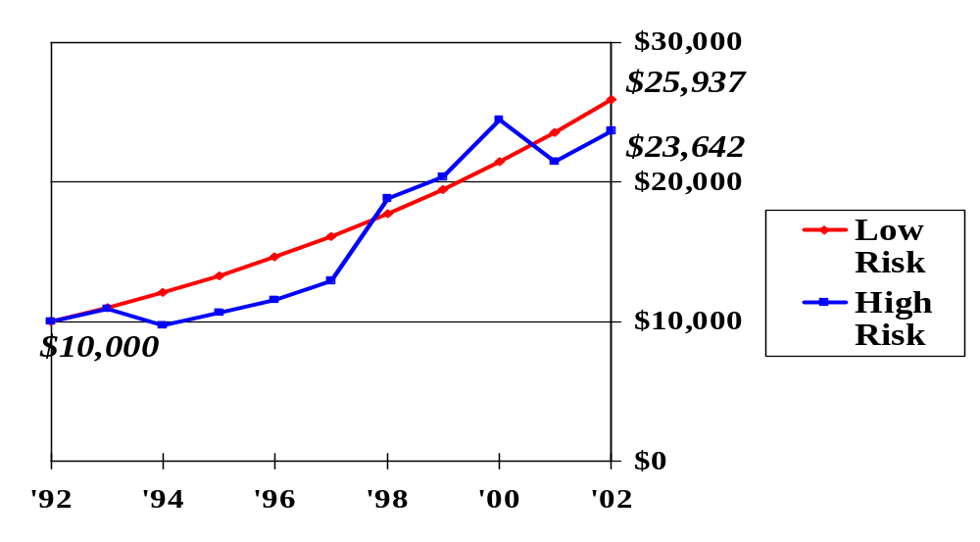
Low Risk vs. High Risk Investments

Slide 11
Low Risk vs. High Risk Investments (cont’d)
Earns 10% per year for each of ten years (low risk)
  Terminal value is $25,937
Earns 9%, -11%, 10%, 8%, 12%, 46%, 8%, 20%, -12%, and 10% in the ten years, respectively (high risk)
  Terminal value is $23,642
The lower the dispersion of returns, the greater the terminal value of equal investments

Slide 12
The Portfolio Manager’s Job
Begins with a statement of investment policy, which outlines:
  Return requirements
  Investor’s risk tolerance
  Constraints under which the portfolio must operate

Slide 13
The Six Steps of Portfolio Management
Learn the basic principles of finance
Set portfolio objectives
Formulate an investment strategy
Have a game plan for portfolio revision
Evaluate performance
Protect the portfolio when appropriate

Slide 14
The Six Steps of Portfolio Management (cont’d)
Learn the Basic
Principles of Finance
(Chapters 1 – 3)
Set Portfolio Objectives
(Chapters 4 – 5)
Evaluate
Performance
(Chapters 19 - 20)
Protect the
Portfolio When
Appropriate
(Chapters 21 – 25)
Formulate an
Investment Strategy
(Chapters 6 – 14)
Have a Game Plan for
Portfolio Revision
(Chapters 15 – 18)

Slide 15
Overview of the Text
PART ONE: Background, Basic Principles, and Investment Policy
PART TWO: Portfolio Construction
PART THREE: Portfolio Management
PART FOUR: Portfolio Protection and Contemporary Issues

Slide 16
PART ONE
Background, Basic Principles, and Investment Policy
A person cannot be an effective portfolio manager without a solid grounding in the basic principles of finance
Egos sometimes get involved
  Take time to review “simple” material
  Fluff and bluster have no place in the formation of investment policy or strategy

Slide 17
PART ONE
Background, Basic Principles, and Investment Policy (cont’d)
There is a distinction between “good companies” and “good investments”
  The stock of a well-managed company may be too expensive
  The stock of a poorly-run company can be a great investment if it is cheap enough

Slide 18
PART ONE
Background, Basic Principles, and Investment Policy (cont’d)
The two key concepts in finance are:
  A dollar today is worth more than a dollar tomorrow
  A safe dollar is worth more than a risky dollar
These two ideas form the basis for all aspects of financial management

Slide 19
PART ONE
Background, Basic Principles, and Investment Policy (cont’d)
Other important concepts
  The economic concept of utility
  Return maximization

Slide 20
PART ONE
Background, Basic Principles, and Investment Policy (cont’d)
Setting objectives
  It is difficult to accomplish your objectives until you know what they are
  Terms like growth or income may mean different things to different people

Slide 21
PART ONE
Background, Basic Principles, and Investment Policy (cont’d)
Investment policy
  The separation of investment policy from investment management is a fundamental tenet of institutional money management
    Board of directors or investment policy committee establish policy
    Investment manager implements policy

Slide 22
PART TWO
Portfolio Construction
Formulate an investment strategy based on the investment policy statement
  Portfolio managers must understand the basic elements of capital market theory
    Informed diversification
    Naïve diversification
    Beta

Slide 23
PART TWO
Portfolio Construction (cont’d)
International investment
  Emerging markets carry special risk
  Emerging markets may not be informationally efficient

Slide 24
PART TWO
Portfolio Construction (cont’d)
Stock categories and security analysis
  Preferred stock
  Blue chips, defensive stocks, cyclical stocks
Security screening
  A screen is a logical protocol to reduce the total to a workable number for closer investigation

Slide 25
PART TWO
Portfolio Construction (cont’d)
Debt securities
  Pricing
  Duration
    Enables the portfolio manager to alter the risk of the fixed-income portfolio component
  Bond diversification

Slide 26
PART TWO
Portfolio Construction (cont’d)
Pension funds
  Significant holdings in gold and timberland (real assets)
  In many respects, timberland is an ideal investment for long-term investors with no liquidity problems

Slide 27
PART THREE
Portfolio Management
Subsequent to portfolio construction:
  Conditions change
  Portfolios need maintenance

Slide 28
PART THREE
Portfolio Management (cont’d)
Passive management has the following characteristics:
  Follow a predetermined investment strategy that is invariant to market conditions or
  Do nothing
  Let the chips fall where they may

Slide 29
PART THREE
Portfolio Management (cont’d)
Active management:
  Requires the periodic changing of the portfolio components as the manager’s outlook for the market changes

Slide 30
PART THREE
Portfolio Management (cont’d)
Options and option pricing
  Black-Scholes Option Pricing model
  Option overwriting
    A popular activity designed to increase the yield on a portfolio in a flat market
  Use of stock options under various portfolio scenarios

Slide 31
PART THREE
Portfolio Management (cont’d)
Performance evaluation
  Did the portfolio manager do what he or she was hired to do?
    Someone needs to verify that the firm followed directions
  Interpreting the numbers
    How much did the portfolio earn?
    How much risk did the portfolio bear?
    Must consider return in conjunction with risk

Slide 32
PART THREE
Portfolio Management (cont’d)
Performance evaluation (cont’d)
  More complicated when there are cash deposits and/or withdrawals
  More complicated when the manager uses options to enhance the portfolio yield
Fiduciary duties
  Responsibilities for looking after someone else’s money and having some discretion in its investment

Slide 33
PART FOUR
Portfolio Protection and Contemporary Issues
Portfolio protection
  Called portfolio insurance prior to 1987
  A managerial tool to reduce the likelihood that a portfolio will fall in value below a predetermined level

Slide 34
PART FOUR
Portfolio Protection and Contemporary Issues (cont’d)
Futures
  Related to options
  Use of derivative assets to:
    Generate additional income
    Manage risk
Interest rate risk
  Duration

Slide 35
PART FOUR
Portfolio Protection and Contemporary Issues (cont’d)
Contemporary issues
  Derivative securities
  Tactical asset allocation
  Program trading
  Stock lending
  CFA program

